Slide 1
LINFLEX
Version 1.0

Slide 2
LINFLEX
LINFLEX / Overview

Slide 3
LINFLEX Overview Features
LIN Protocol Handler
Master mode
Slave mode
LIN message buffer
Filtering Unit (slave)
Re-synchronization (slave)
Enhanced error detection
Standard UART/SCI mode
CONTROL STATUS REGISTERS
RX/TX
MESSAGE
BUFFER
Filtering Unit
LIN 1.3/2.0/2.1/J2602 Protocol Handler
LIN TX
LIN RX

Slide 4
LINFLEX Overview Protocol handler - Master mode
Header and response handling without CPU intervention
Header
Transmission without dead-time
Synch Break length configurable from 10 to 36 bit times (COOLING)
Response
Transmission without dead-time
Transmission confirmation
Reception indication
TX Confirmation
HEADER
TX DATA
CRC
TRANSMIT RESPONSE
RX Indication
Slave Response Latency
HEADER
RX DATA
CRC
RECEIVE RESPONSE
HEADER
IGNORE RESPONSE

Slide 5
LINFLEX Overview Protocol Handler - Slave mode
Header and response handling with minimum CPU intervention
Header
Indication after reception of a correct identifier
Break detection threshold of 10 or 11-bit
Response
Transmission confirmation
Reception indication
Indication
TX Confirmation
HEADER
TX DATA
CRC
TRANSMIT RESPONSE
Indication
RX Indication
Response Latency
HEADER
RX DATA
CRC
RECEIVE RESPONSE
Indication
HEADER
IGNORE RESPONSE

Slide 6
LINFLEX Overview Enhanced error detection circuit
Bit error
Detection on all bits transmitted including header, delimiters
Identifier Parity
Break Delimiter
Inconsistent Synch Field
Framing error
Checksum Error
Classic
Enhanced
Slave response timeout
Dedicated timer programmable by application
LINRX stuck dominant
Error signalling
9 error sources
Each error source can be independently enabled/disabled

Slide 7
LINFLEX Overview Buffer
The message buffer
Ensures data consistency
Eases message handling by the application
Event Signalling
Overrun
IDENTIFIER / DLC
DATA
CONTROL STATUS REGISTERS
CRC
Filtering Unit
LIN 1.3/2.0 Protocol Handler
LIN TX
LIN RX

Slide 8
LINFLEX Overview System
32-bit memory model
Low Power Modes
Configurable wake-up pulse
Robustness
Configuration registers protection in RUN mode
LINTX signal forces recessive when in SLEEP mode or STOP mode
Diagnostic
Loop-back mode
LINRX readable
FSM status readable
CONTROL STATUS REGISTERS
RX
MESS
BUF
Filtering
LIN 1.3/2.0 Protocol Handler
LIN TX
LIN RX

Slide 9
LINFLEX Overview UART mode
Mode
Full Duplex
8-bit / 9-bit /16-bit / 17-bit
Even / Odd parity
Transmit Buffer
Depth configurable from 1 to 4
Receive Buffer
Depth configurable from 1 to 4
Error
Parity
Overrun
CONTROL STATUS REGISTERS
TRANSMIT
BUFFER
4 BYTES
RECEIVE
BUFFER
4 BYTES
UART/SCI CORE
LIN TX
LIN RX

Slide 10
LINFLEX
LINFLEX / Master mode
Frame handling

Slide 11
LINFLEX Master mode – Frame handling
DRIE=1
Reception
Completed
Get Data
Transmission
Reception
RX
Header
Data TX
Ch
Header
Data RX
Ch
Software configures ID, Data length, direction, fill Data Buffer and request transmission
Software configures ID, Data length, direction, fill Data Buffer and request transmission
Interrupt to notify reception completed and data available
Get data in buffer

Slide 12
LINFLEX Master mode – Frame handling Bit error (idle on bit error enable)
DRIE=1
BEIE=1
Reception
Completed
Get Data
IOBE=1
Transmission
Bit Error
Reception
ERR
RX
Header
Data TX
Ch
Header
Data RX
Ch
BEIE=1
BEIE=1
IOBE=1
IOBE=1
Trans.
Bit Error
Rec.
Bit Error
ERR
ERR
Header
Header
Communication stopped immediately
Interrupt to notify bit error

Slide 13
LINFLEX Master mode – Frame handling bit error (idle on bit error disable)
DRIE=1
BEIE=1
Reception
Completed
Get Data
IOBE=0
DTIE=1
Transmission
Bit Error
Reception
ERR
RX
Header
Data TX
Ch
Header
Data RX
Ch
DRIE=1
BEIE=1
BEIE=1
Reception
Completed
Get Data
IOBE=0
DTIE=1
IOBE=0
Trans.
Bit Error
Rec.
Bit Error
ERR
ERR
RX
Header
Data TX
Ch
Header
Data RX
Ch
Software can take appropriate action on Bit Error interrupt
=> Not used

Slide 14
LINFLEX Master mode – Frame handling Checksum error
Reception
Checksum error
ERR
Header
Data RX
Ch
Transmission
(Checksum error)
ERR
Header
Data TX
Ch
When transmitting response, a bit error will always come before a checksum error, thanks to the data read back

Slide 15
LINFLEX Master mode – Frame handling Response and Frame timeout
Response Time-out
ERR
Header
Data RX or Data TX
Timeout can be disable
LIN standard does not require to check for frame length
Can be used for test and debugging purpose
OC1
T_{Response_Max}
Frame Time-out
ERR
Header
Data RX or Data TX
OC2
11-bit
dominant
T_{Frame_Max}

Slide 16
LINFLEX
LINFLEX / Master mode
State machine

Slide 17
LINFLEX Master mode – State machine Data transmission
Idle
HTRQ
Synch Break
Data Transmission
Bit error checked by HW (optional)
Synch Del
Bit error checked by HW (optional)
Checksum
Checksum checked by HW (optional)
Synch Field
Identifier Field
Header Transmission completed

Slide 18
LINFLEX Master mode – State machine Bit error in header
Idle
HTRQ
Synch Break
Bit error
Synch Del
Bit error checked in all header states: break, del, synch field, ID field (optional)
Bit error
Synch Field
Bit error
Identifier Field
Bit error

Slide 19
LINFLEX Master mode – State machine Bit error during data transmission
Idle
HTRQ
Synch Break
Data Transmission
Bit error
Synch Del
Bit error checked by HW (optional)
Checksum
Bit error
Synch Field
Bit error checked in all response states (optional)
Identifier Field
Header Transmission completed

Slide 20
LINFLEX Master mode – State machine Data reception
Idle
HTRQ
Synch Break
Data Reception
Framing error checked by HW
Synch Del
Bit error checked by HW (optional)
Checksum
Checksum checked by HW
Synch Field
Checksum Byte
Identifier Field
Header Transmission completed

Slide 21
LINFLEX Master mode – State machine Data reception - Timeout
Idle
Response and Frame time-out are optional
HTRQ
Synch Break
Data Reception
Time-out
Synch Del
Bit error checked by HW
Checksum
Time-out
Synch Field
Checksum Byte
Response and Frame time-out are optional
Identifier Field
Header Transmission completed

Slide 22
LINFLEX
LINFLEX / Slave mode
Frame handling

Slide 23
LINFLEX Slave mode – Frame handling Filters disable
DRIE=1
HRIE=1
HRIE=1
Reception
Completed
Get Data
Header reception
Data Transmission
Header reception
Data Reception
RX
RX
RX
Header
Data TX
Ch
Header
Data RX
Ch
HRIE=1
Header reception
Data Discard
Software gets data in buffer
RX
Header
Header reception notification
Software configures data length and chooses direction or disable reception

Slide 24
LINFLEX Slave mode – Frame handling Extended frames
Buffer
Empty
Get Data
Buffer
Empty
Get Data
Reception
Completed
Get Data
Header reception
Data Reception
RX
RX
RX
RX
CHE = 0
Header
Data RX
Data RX
Data RX
Buffer
Empty
Get Data
Buffer
Empty
Get Data
Reception
Completed
Get Data
Header reception
Data Reception
RX
RX
RX
RX
CHE = 1
Header
Data RX
Data RX
Data RX
Ch
This mode allow to manage more than 8 data byte frames
Speed-up In Application Programming

Slide 25
LINFLEX Slave mode – Frame handling Bit error (filters disable)
Reception
Completed
Get Data
Header reception
Data transmission
Header reception
Data reception
Bit Error
RX
ERR
RX
RX
Header
Data TX
Ch
Header
Data RX
Ch
Header reception
Data Discard
RX
Header
Communication stopped immediately
Interrupt to notify bit error

Slide 26
LINFLEX Slave mode – Frame handling Bit error (filters disable)
Reception
Completed
Get Data
Header reception
Data transmission
Header reception
Data reception
Bit Error
RX
ERR
RX
RX
Header
Data TX
Ch
Header
Data RX
Ch
Header reception
Data Discard
RX
Header
Communication stopped immediately
Interrupt to notify bit error
Idle on bit error can be disable to let software take the appropriate action

Slide 27
LINFLEX Slave mode – Frame handling Checksum error (filters disable)
Header reception
Data transmission
Header reception
Data reception
(Checksum error)
Checksum error
RX
ERR
RX
ERR
Header
Data TX
Ch
Header
Data RX
Ch
Header reception
Data Discard
RX
Header

Slide 28
LINFLEX Slave mode – Frame handling Header, Response and Frame timeout
Header Time-out
Response Time-out
ERR
ERR
Header
Header
Data RX or Data TX
OC1
OC1
11-bit
dominant
T_{Response_Max}
Frame Time-out
T_{Header_Max}
ERR
Header
Data RX or Data TX
Timeout can be disable
LIN standard does not require to check for frame length
Can be used for test and debugging purpose
OC2
11-bit
dominant
T_{Frame_Max}

Slide 29
LINFLEX
LINFLEX / Slave mode
State machine

Slide 30
LINFLEX Slave mode – State machine Data transmission
Idle
Falling edge
Synch Break
DTRQ
Data Transmission
Bit error checked by HW
Dominant > 11-bit
Synch Del
Checksum
Checksum checked by HW
Del > 1-bit
Synch Field
0x55
Identifier Field
Byte
Header Reception completed

Slide 31
LINFLEX Slave mode – State machine Data reception
Idle
Falling edge
Synch Break
Data Reception
Framing error checked by HW
Dominant > 11-bit
Synch Del
Checksum
Checksum checked by HW
Del > 1-bit
Synch Field
Checksum Byte
0x55
Identifier Field
Byte
Header Reception completed

Slide 32
LINFLEX Slave mode – State machine Data discard
Idle
Falling edge
Synch Break
Dominant > 11-bit
Synch Del
Del > 1-bit
Synch Field
0x55
Identifier Field
Byte
Header Reception completed
DDRQ

Slide 33
LINFLEX Slave mode – State machine Header not valid
Idle
Falling edge
Dominant < 11-bit
Synch Break
Dominant > 11-bit
Del < 1-bit
Synch Del
Del > 1-bit
Inconsistent (not 0x55)
Synch Field
0x55
Framing error
Identifier Field
ID Parity error (optional)

Slide 34
LINFLEX
LINFLEX / Sampling method

Slide 35
LINFLEX Sampling method Start bit
Common SCI / UART method (applies in UART and LIN modes)
Start
Stop
Start detection
Bit Sampling
x
x
x
x
x
0
1
2
3
4
5
6
7
8
9
10
11
12
13
14
15
0
1
Synchronization (counter reset)

Slide 36
LINFLEX Sampling method Data bits
Common SCI / UART method
Start
Stop
Bit Sampling
11
12
13
14
15
0
1
2
3
4
5
6
7
8
9
10
11
12
13
14
15
0
1
Counter running

Slide 37
LINFLEX Sampling method Break and Del detection
Delimiter check method (applies in LIN mode only)
Del
Del detection
Bit Sampling
x
x
x
x
x
0
1
2
3
4
5
6
7
8
9
10
11
12
13
14
15
0
1
Synchronization (counter reset)

Slide 38
LINFLEX Sampling method Break and Del detection
Minimum Synch Break length accepted = 10 + 10/16 = 10.62 bit time
11th bit Sampling
Del detection
Bit Sampling
4
5
6
7
8
9
0
1
2
3
4
5
6
7
8
9
10
11
12
13
14
15
0
1
Synchronization (counter reset)

Slide 39
LINFLEX
LINFLEX / Slave mode with filters
LINFLEX / Slave mode with filters

Slide 40
LINFLEX Slave node with filters
ID matching a TX filter
ID matching a RX filter
Reception
Completed
Get Data
Header
Transmission
TX
RX
Header
Data TX
Ch
Header
Data RX
Ch
ID not matching any filter
Header
No more software intervention !
Notes:
During reception, it is not needed header interrupt

Slide 41
LINFLEX
Modes

Slide 42
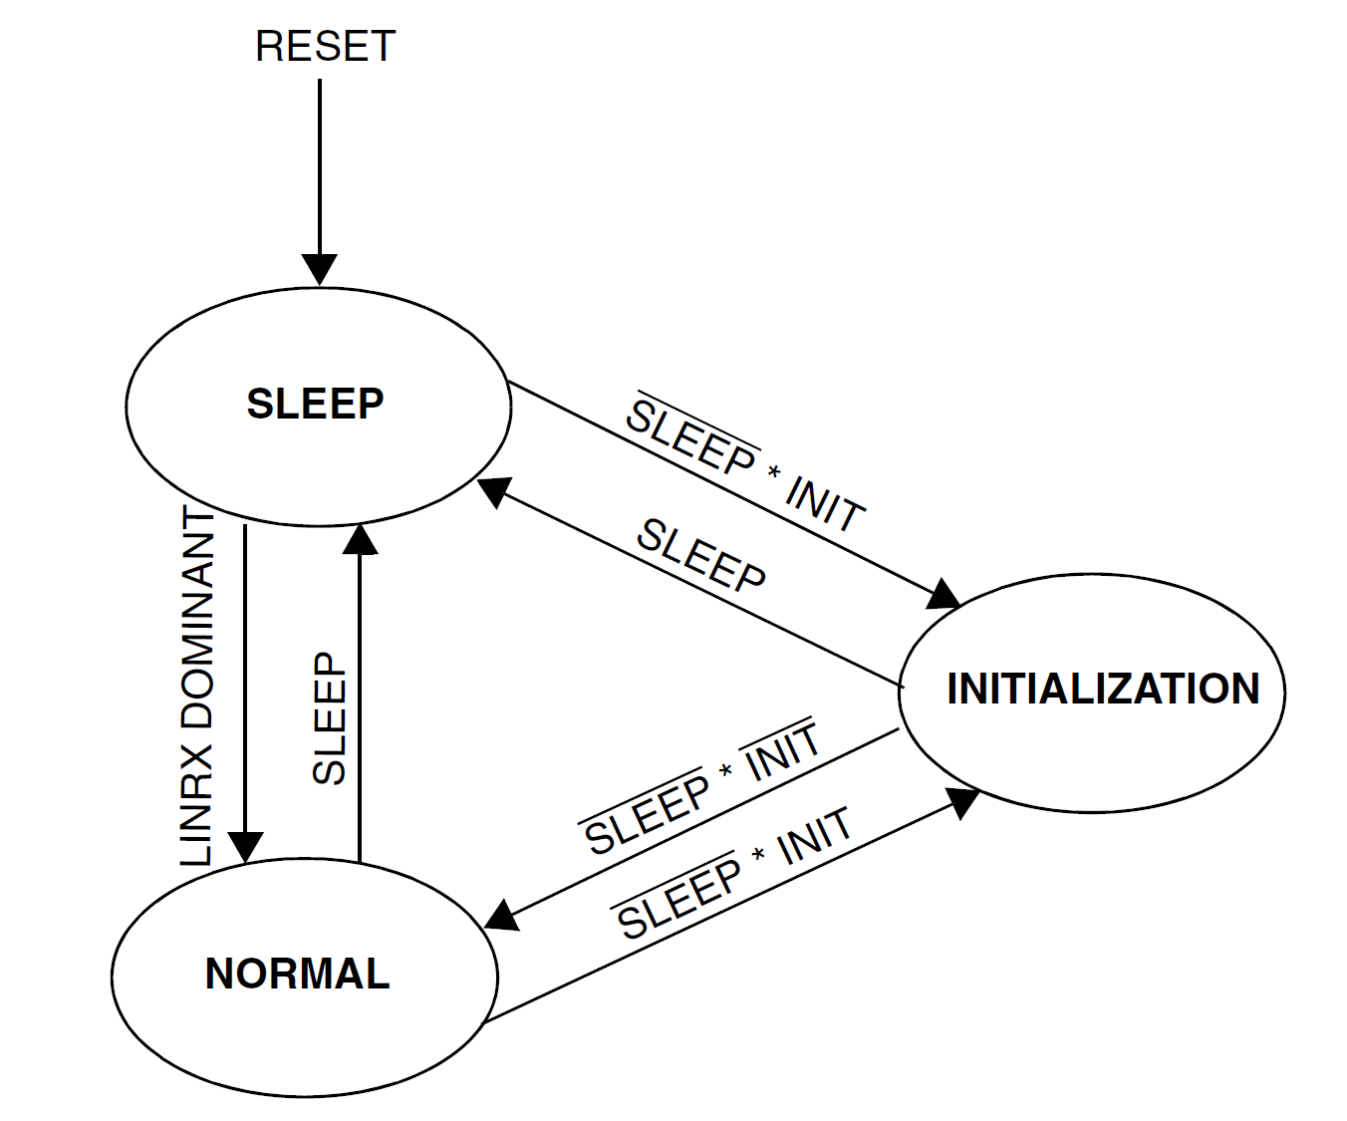
LINFLEX Modes Operating modes

Slide 43
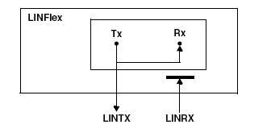
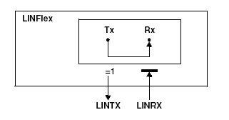
LINFLEX Modes Loopback & self-test modes
Loopback
Selftest

Slide 44
LINFLEX
Registers

Slide 45
LINFLEX Registers
Refer to reference manual

